Slide 1
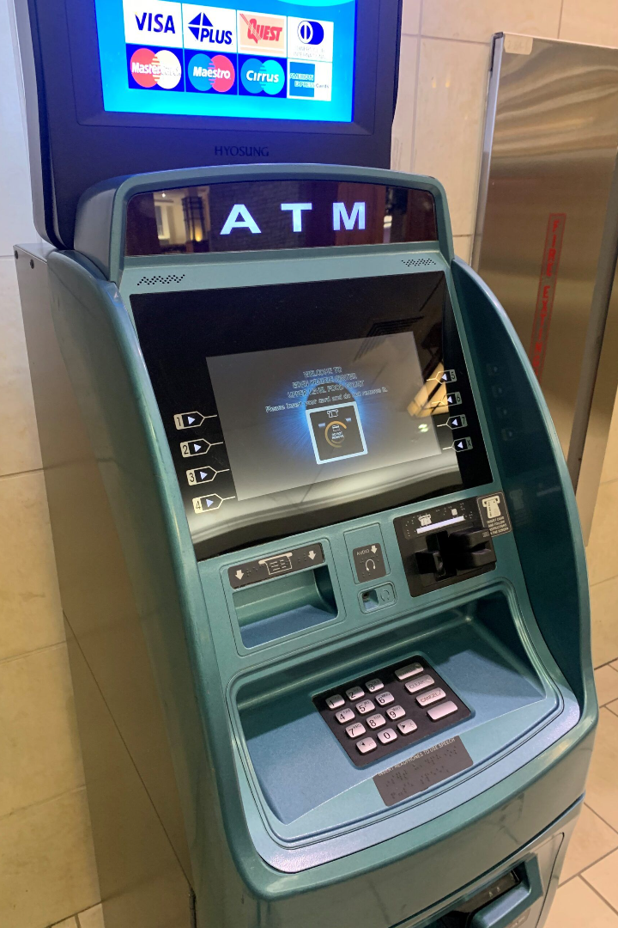
ATM Machine with Python using Tkinter
Welcome to our presentation on how to create an ATM machine with Python and the Tkinter graphical user interface library. In this session, we will explore the Tkinter library and demonstrate how to develop the functionalities of an ATM machine using Python.
By Mohammad Shahid

Slide 2

Introduction to ATM Machine
An overview of the concept of an Automated Teller Machine (ATM).
History of ATM with some interesting facts.
The benefits of using an ATM and the different types of ATM machines available.
The challenges and limitations of current ATM machines and future expectations.

Slide 3

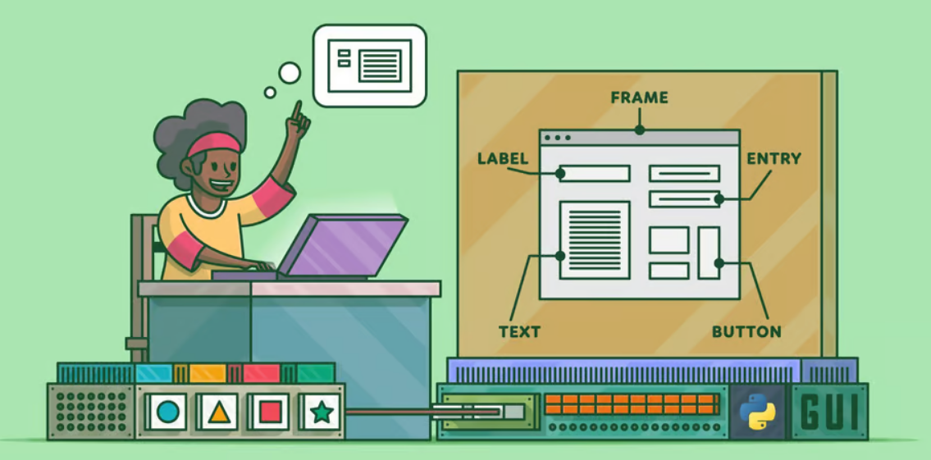
Overview of Tkinter Library
Tkinter is a GUI library that allows Python programmers to create windows, dialogs,
and other GUI applications that run on Windows, macOS, and Linux. This section
explores the features of the Tkinter library and shows how it can be used to develop
an ATM machine GUI.

Slide 4

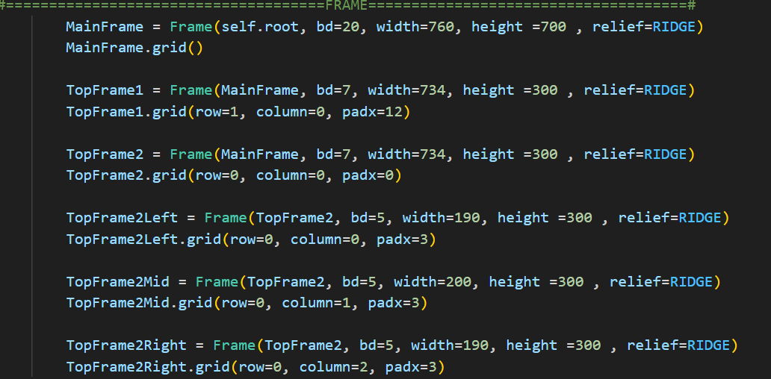
Making Frames
Here we will explore how to make frames of ATM system .
For example: as you can see in the image I have defined
Main Frame and Top Frames and also defined their border,
Width, height and relief by using function frame.

Slide 5

Adding Functions to the GUI Buttons
This section teaches how to add functionalities to the different buttons designed in the GUI. The ATM machine comprises several buttons; this section will provide a detailed explanation on how to code these buttons to simulate various transactions such as a cash withdrawal, balance inquiry, etc.

Slide 6
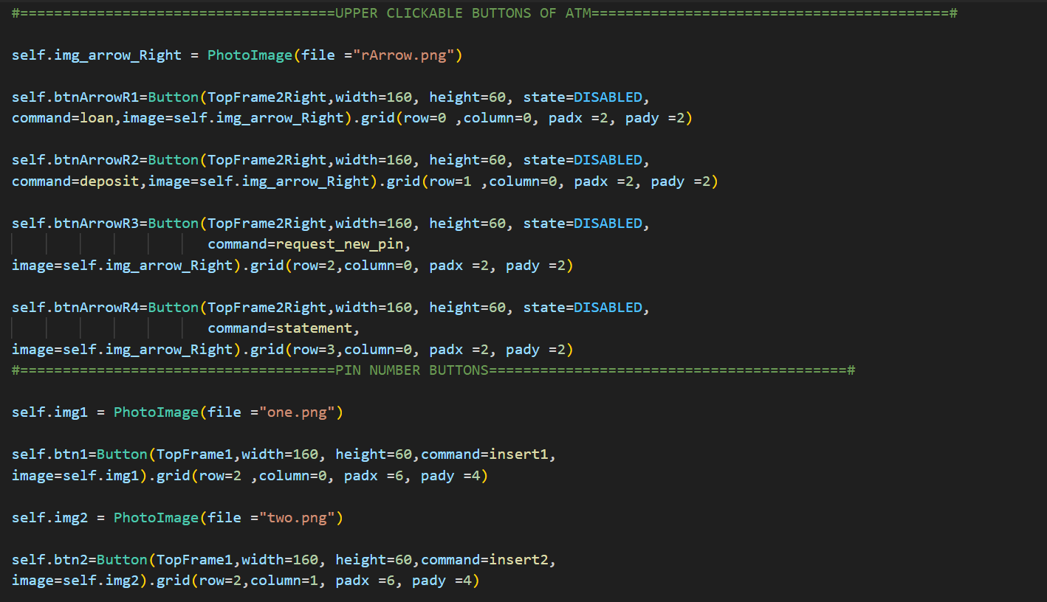
Making ATM Buttons
Firstly we import the button image using PhotoImage
(file=“rArrow.png”) and then make the no. of buttons that
We want to use in our ATM system and set their height,
Width,state,command of function that we want to use as
You can see in image that I made the upper clickable
Buttons and Pin enterting buttons of the ATM system

Slide 7

Simulating the ATM Transactions
In this section, we will simulate various ATM transactions in the GUI window we created earlier in the tutorial. Here we will demonstrate how to code some of the critical transactions such as cash withdrawals, balance inquiries, and deposit transactions.

Slide 8
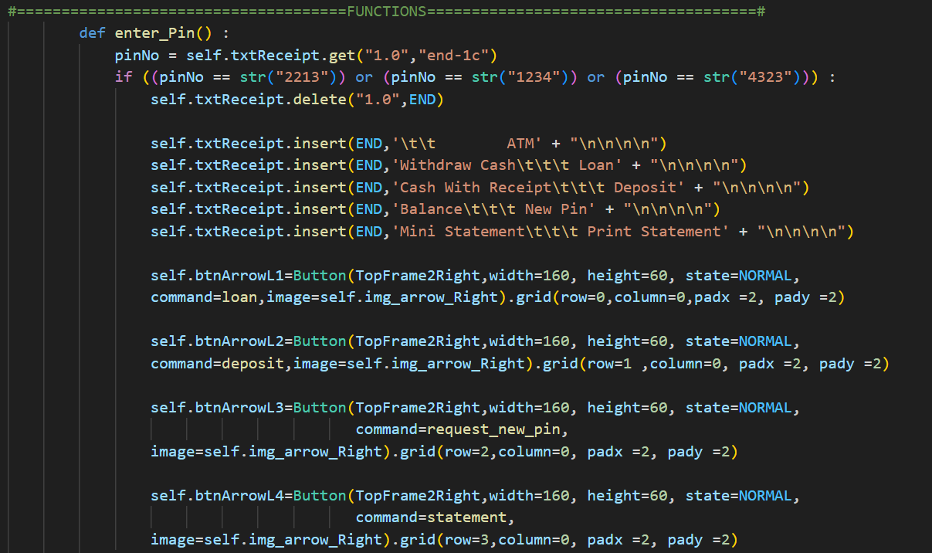
Defining ATM Transactions
Here we will see how to define ATM transactions as you can see in
The image that I have defined some transaction functions like withdraw cash, cash with receipt, deposit, balance, new pin etc.
by using “self.txtReceipt.insert”.

Slide 9

Conclusion and Future Enhancements
We conclude by summarizing our tutorial on creating an ATM machine with Python and Tkinter and highlighting areas where participants can improve the codebase further. Also, we discuss how to personalize the ATM machine design and other future improvements.

